Slide 1

Github Project
MADE BY 4xS

Slide 2
Who are we?
Name | Role
Stefan Georgiev Diomov – X^{G} SGDiomov18@codingburgas.bg | Scrum Trainer
Stoicho Denchev Dimitrov – X^{B} SDDimitrov18@codingburgas.bg | Back-end developer
Stefan Plamenov Ganchev – X^{B} SPGanchev18@codingburgas.bg | Front-end developer

Slide 3

About the project
To Develop school system to help with school management

Slide 4
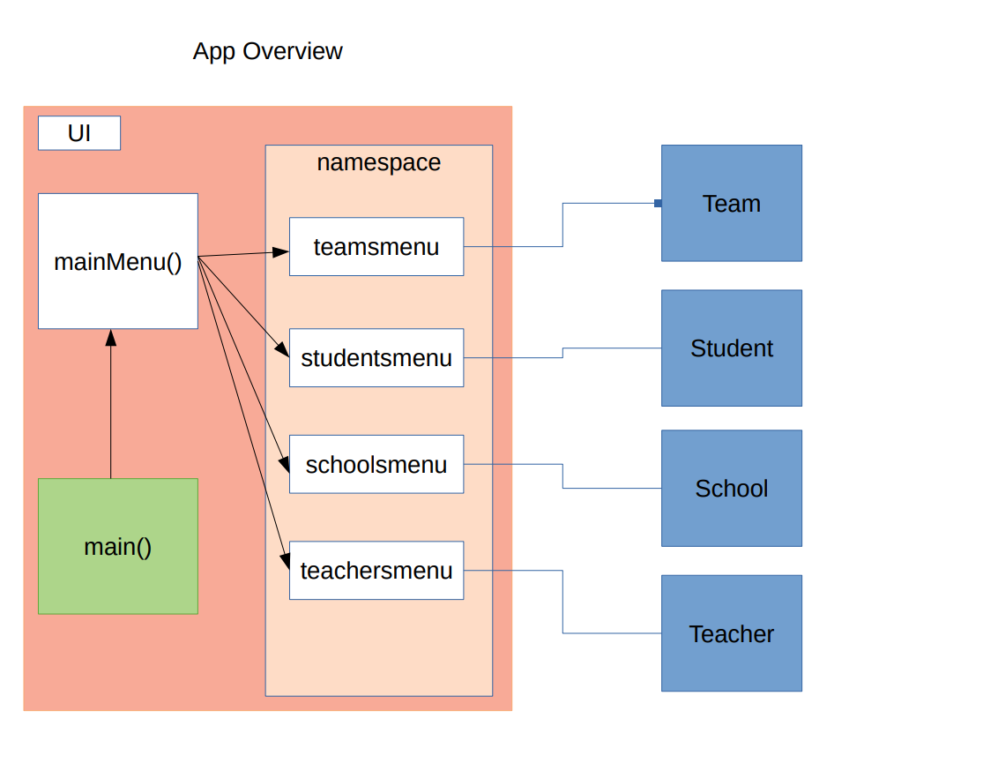
How does the app work?

Slide 5

Difficulties we went through
The cohesion between writing and reading data from the files and using that data to create objects. Communication between teammates.

Slide 6



Used technologies

Slide 7



Future improvements
To add UI (user interface)
To replace the .csv files with database

Slide 8

Thank you for your attention!

